Slide 1
ECE 105: Introduction to Electrical Engineering
Lecture 12
Bio 2
Yasser Khan
Rehan Kapadia

Slide 2
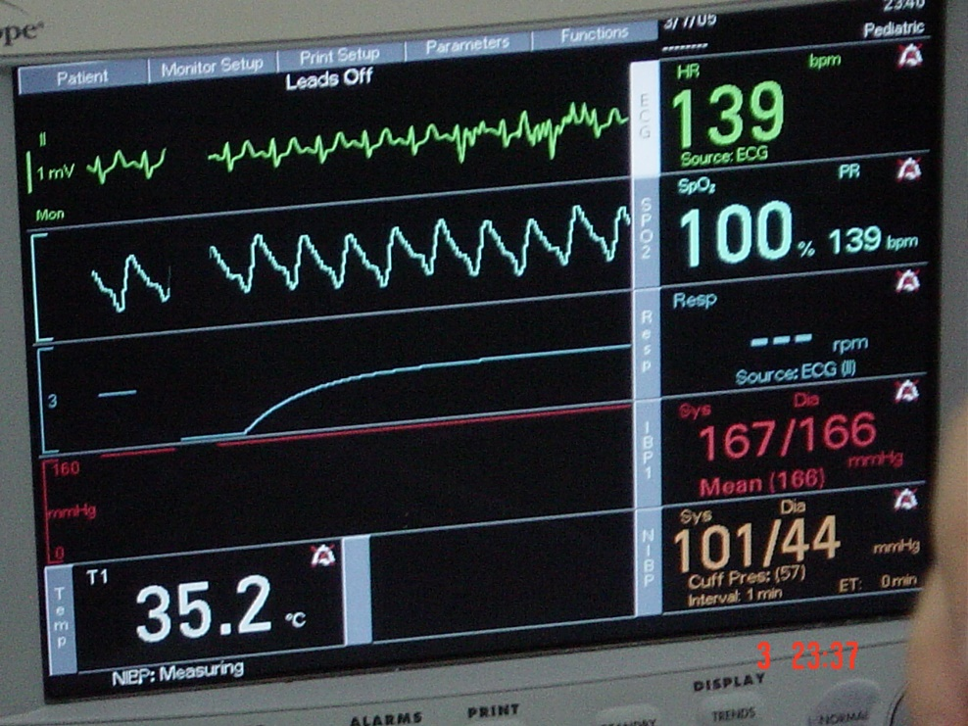
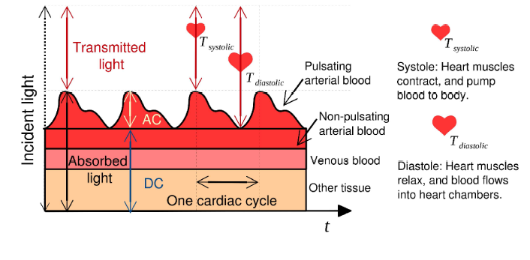
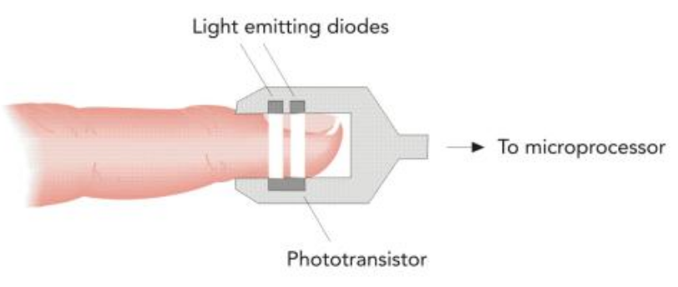
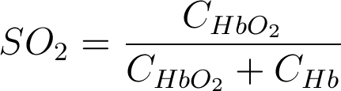
Pulse oximetry
ECG
Pulse oximetry measures blood oxygenation. Using spectrophotometry of absorptivity of blood at two distinct wavelengths, blood oxygen saturation is quantified.
Can detect hypoxemia, ie. lower than normal blood oxygenation.
Pulse Ox
Respiration
Blood
Pressure
Temperature
SO₂ The saturation of oxygen in blood,
C_{HbO2} Concentration of oxygenated hemoglobin (HbO₂),
C_{Hb} Concentration of deoxygenated hemoglobin (Hb).

Slide 3
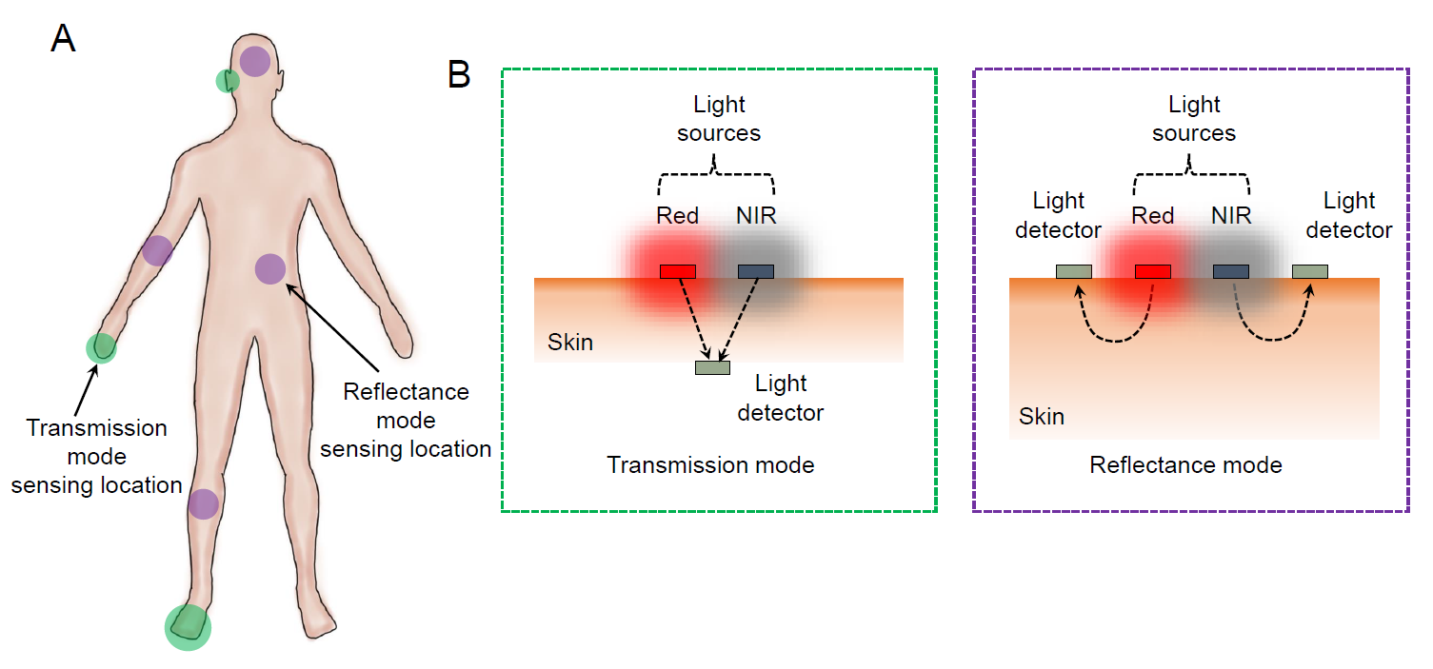
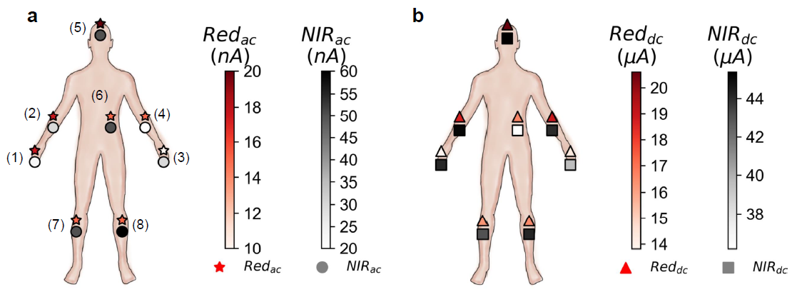




Transmission vs. reflectance oximetry
Transmission-mode pulse oximetry is limited only to tissues that can be transilluminated, such as the earlobes and the fingers.
If reflected light is used as the signal, the sensor can be used beyond the conventional sensing locations.
AC signal is the highest at the forehead for both Red and NIR channels.
Arms provide mid-range AC amplitude, while signal strength is low in the legs and chest area.
Forehead is the best location for reflectance pulse oximetry.

Slide 4
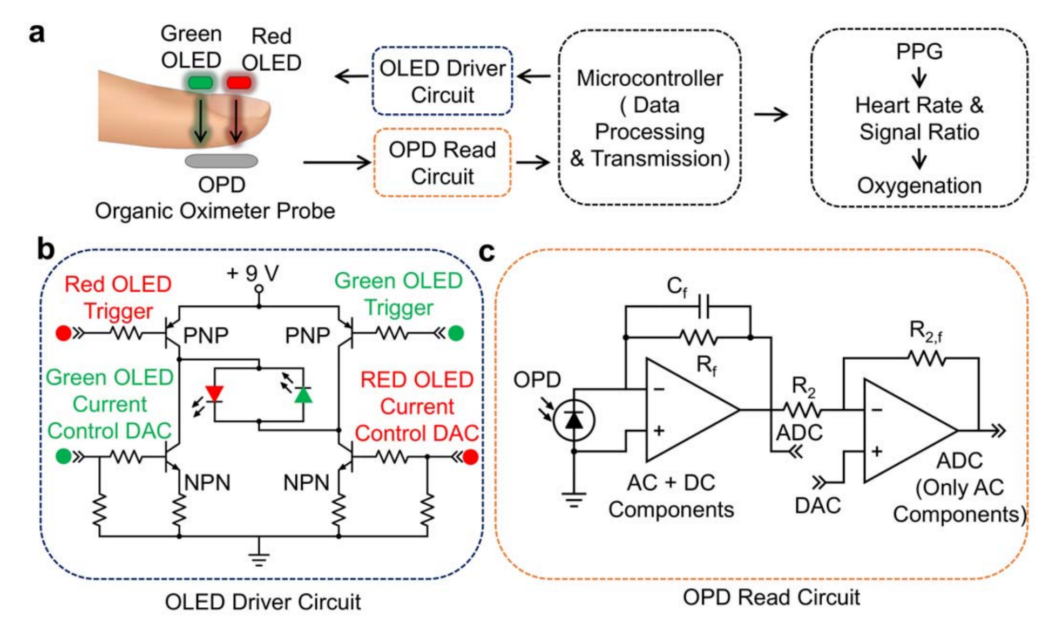











Oximeter readout circuit

Slide 5



























Oximeter readout circuit

Slide 6
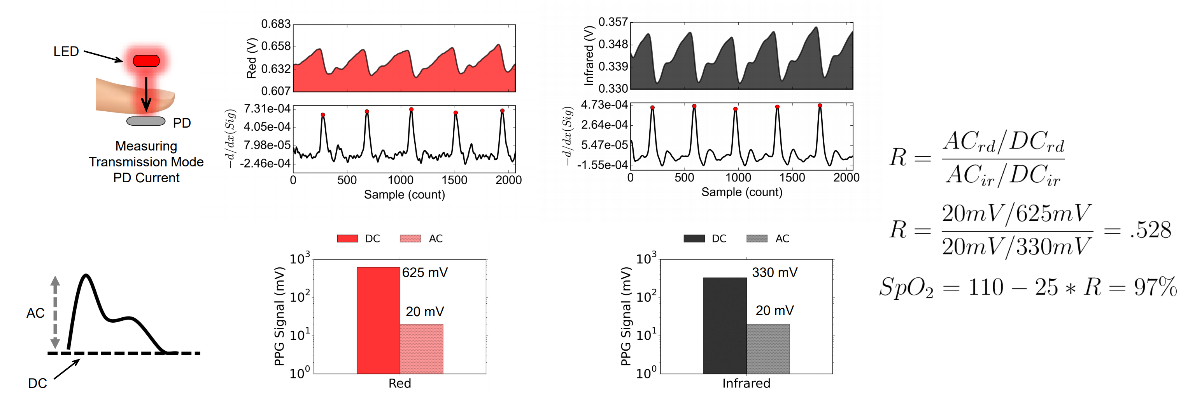

Calculating oxygen saturation

Slide 7
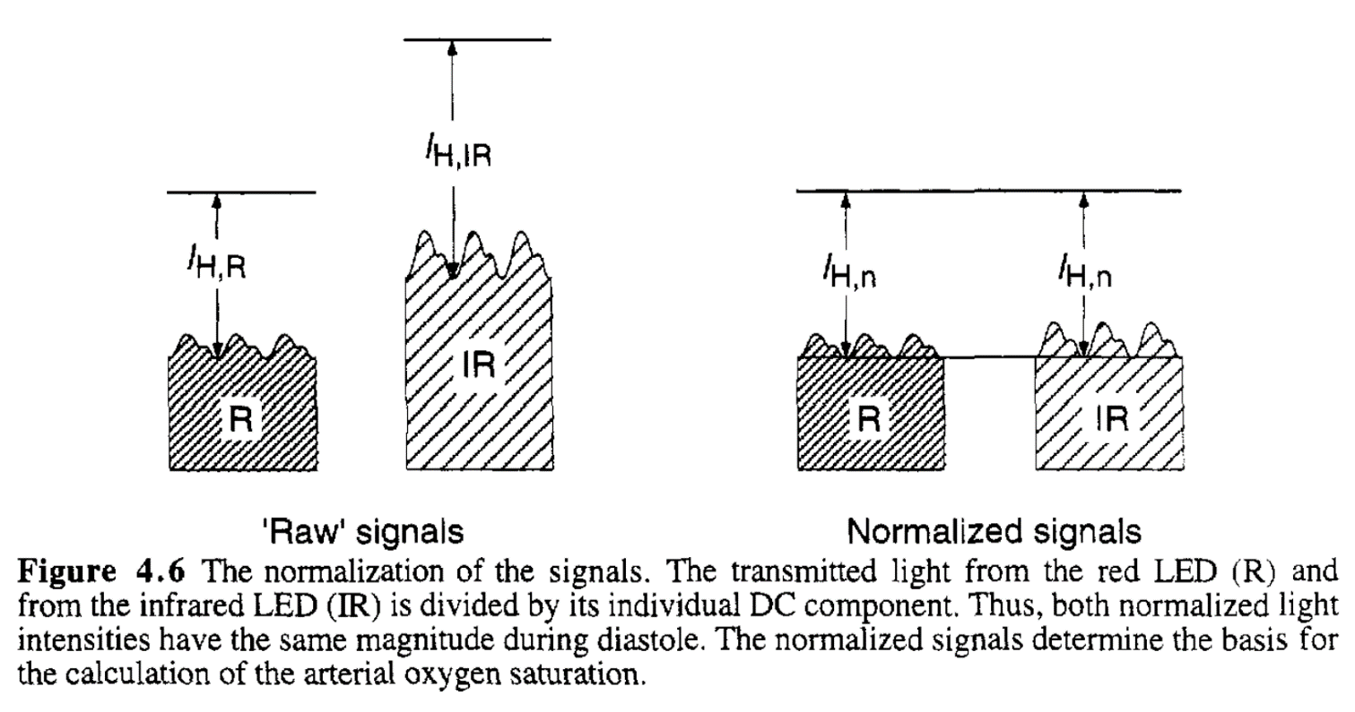
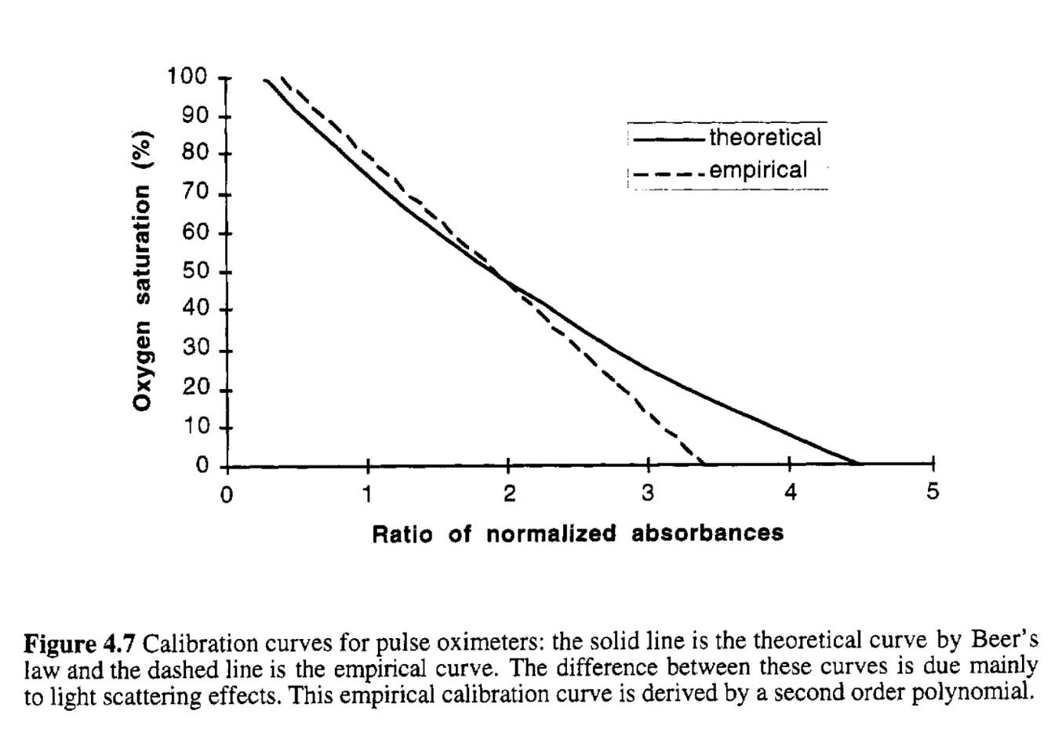












Pulse oximeter basics

Slide 8


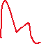













Slide 9
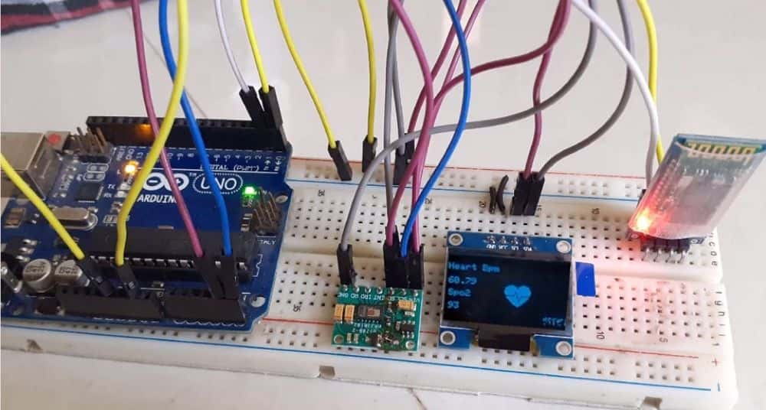
Oximeter prototype

Slide 10
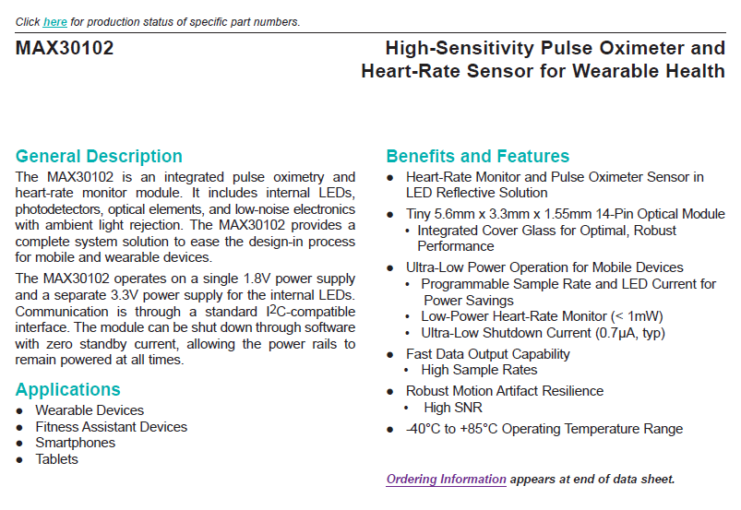


AFE – MAX30102

Slide 11
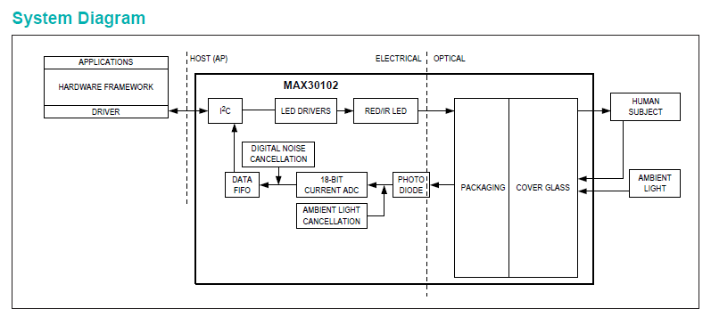




System design

Slide 12
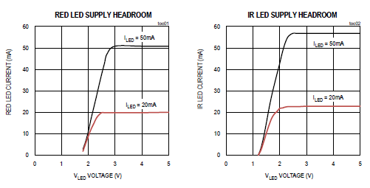




LEDs

Slide 13
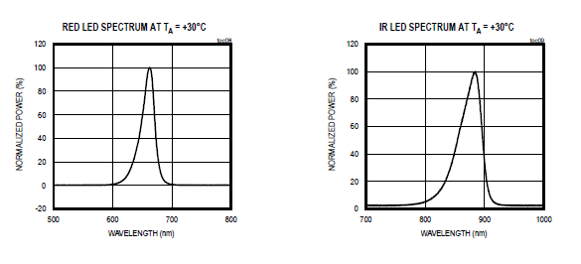
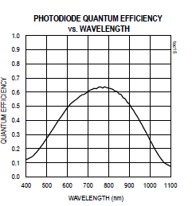




LED – PD spectrum

Slide 14
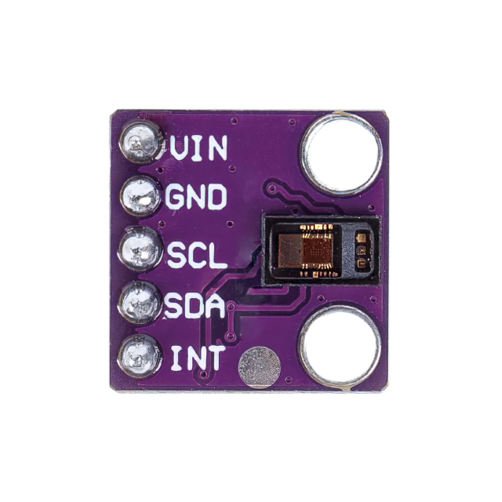
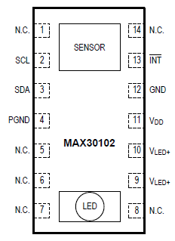



Connection

Slide 15
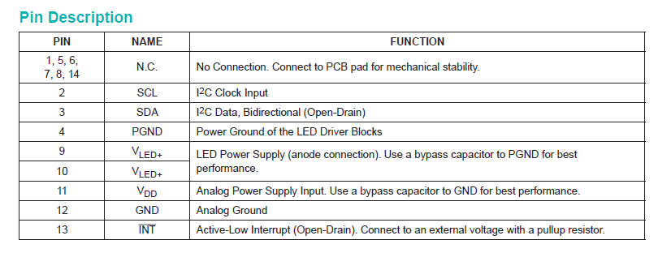






Connection

Slide 16
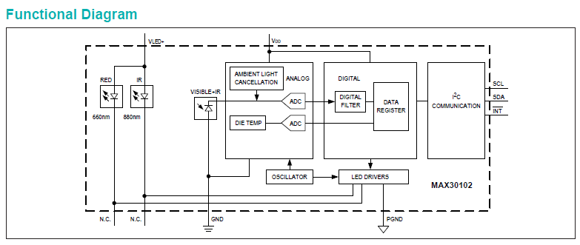
How does the AFE work

Slide 17
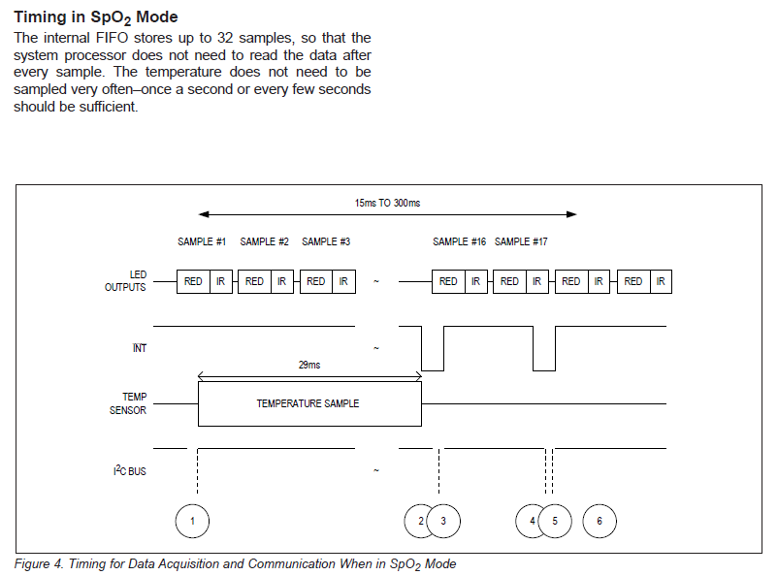
Data capture

Slide 18
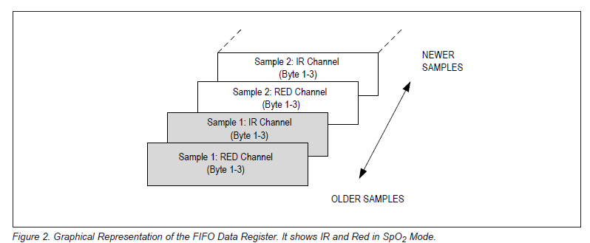
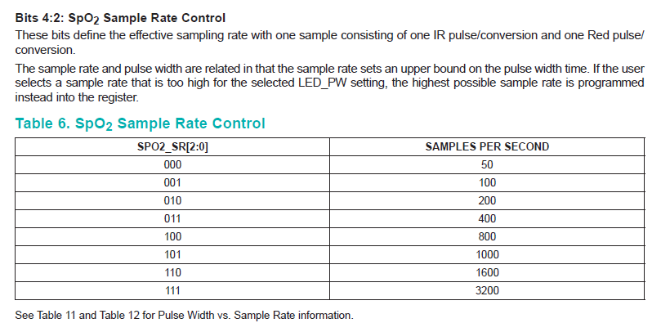

Data capture

Slide 19
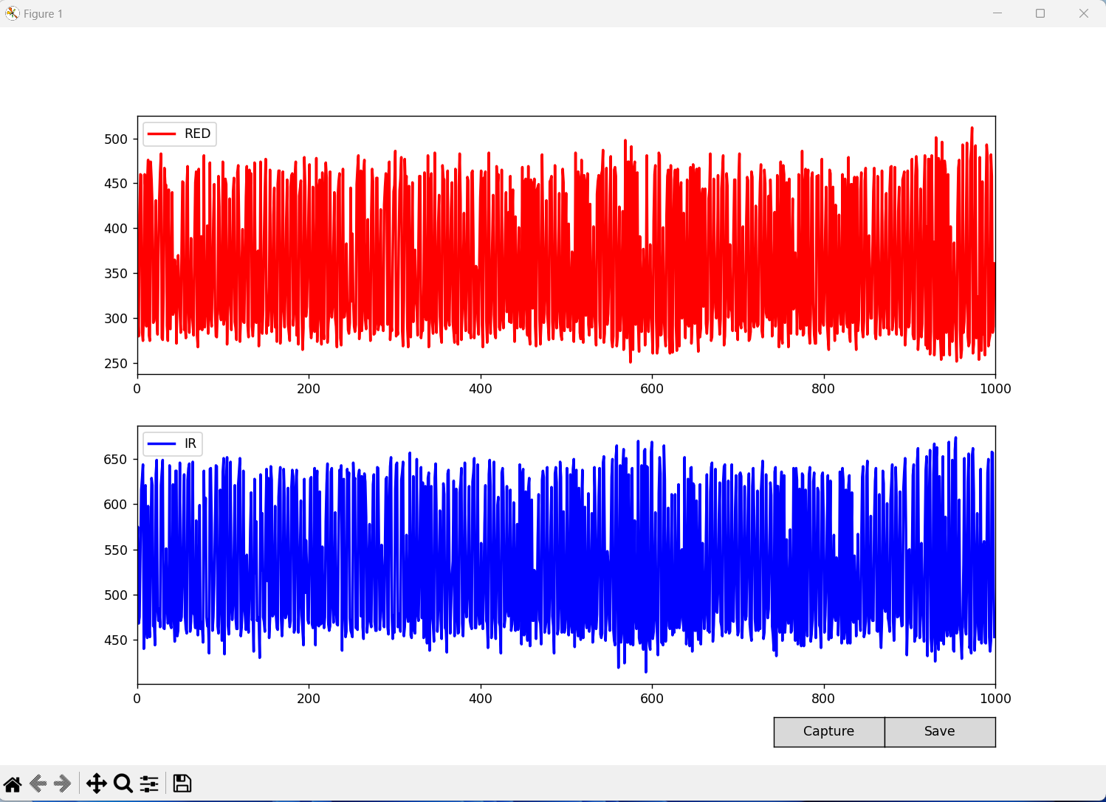
Press capture

Slide 20
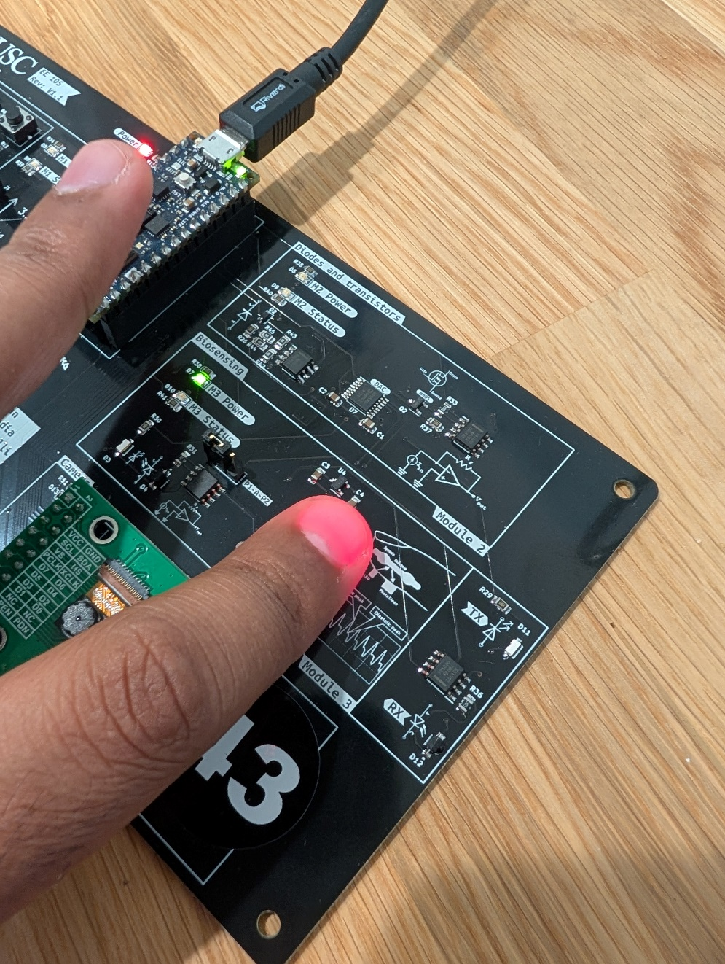
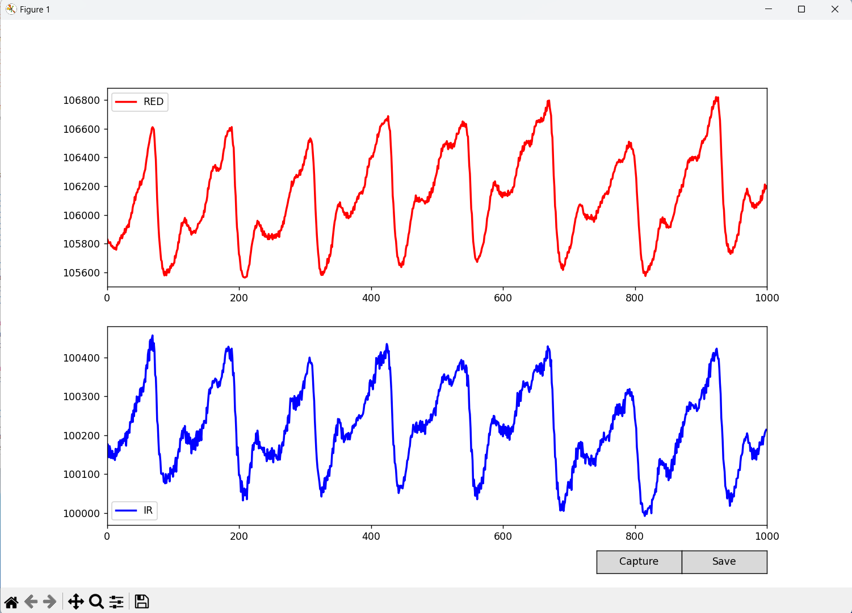
Keep your finger gently on the sensor

Slide 21
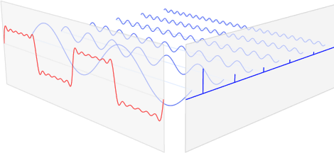

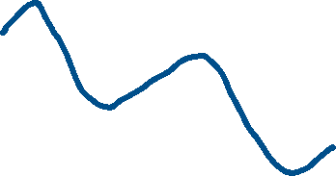
Time domain to frequency domain
The Fourier transform is an analysis process, decomposing a complex-valued function into its constituent frequencies and their amplitudes.

Slide 22
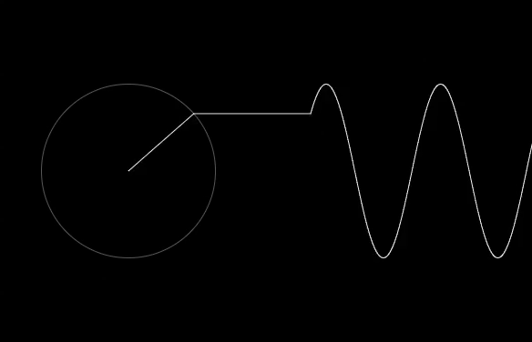
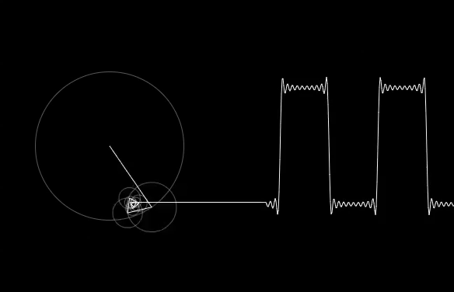





Time domain to frequency domain
The Fourier transform is an analysis process, decomposing a complex-valued function into its constituent frequencies and their amplitudes.

Slide 23
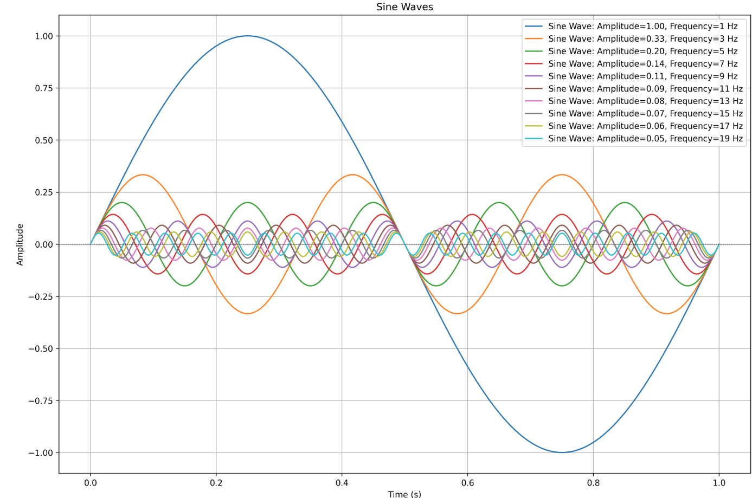



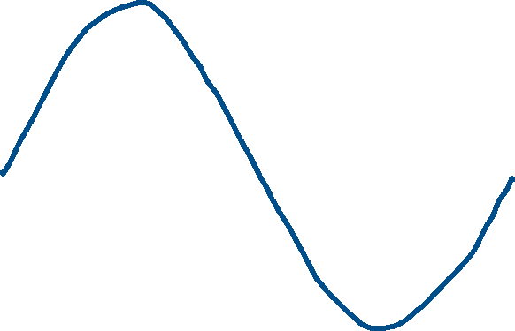
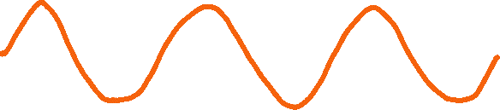

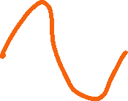


Time domain to frequency domain

Slide 24
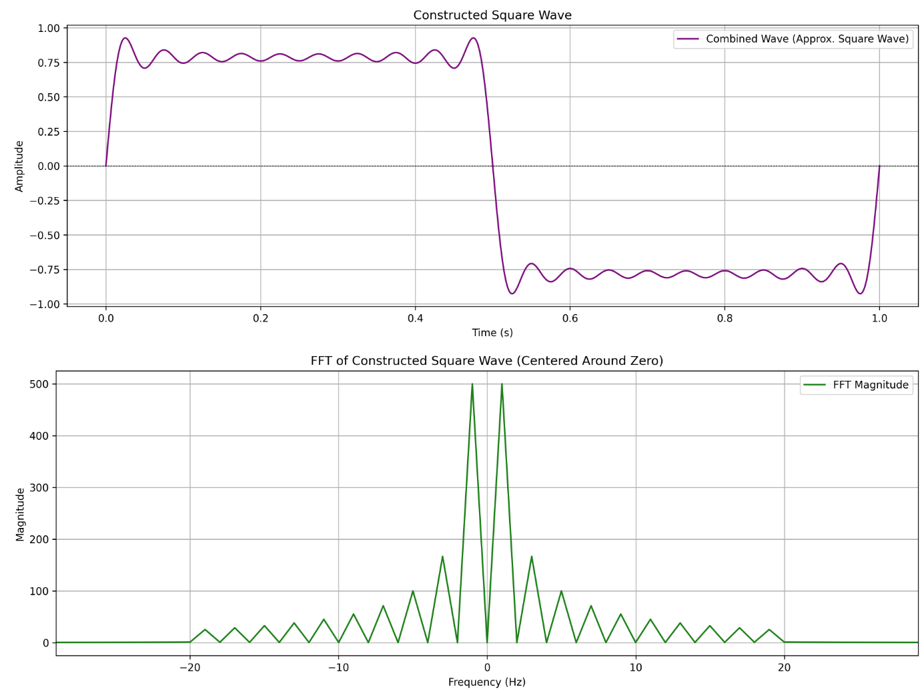
What makes a square wave

Slide 25
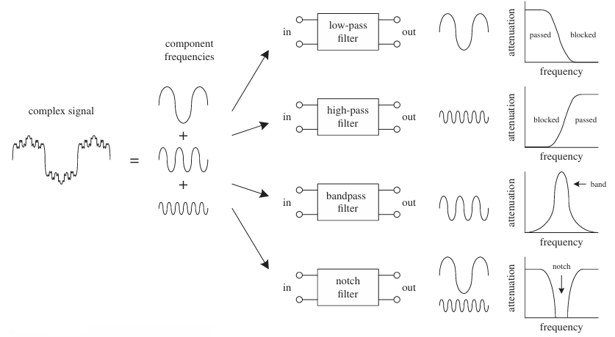







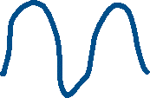
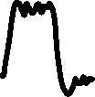

Filters

Slide 26
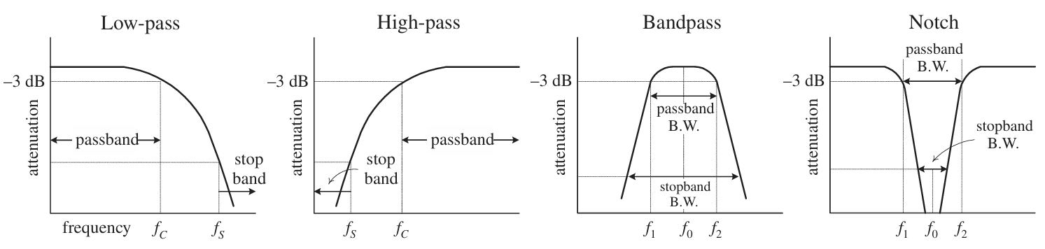

Filters

Slide 27
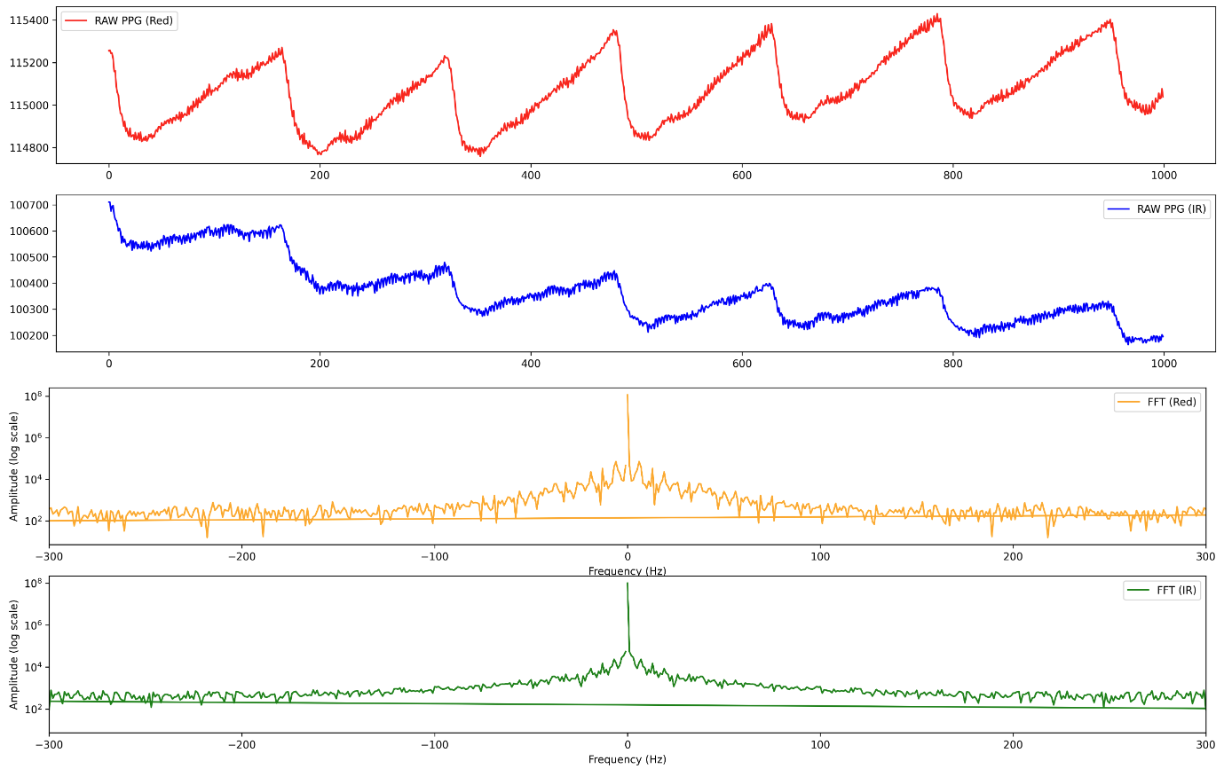


Going back to the PPG data collected

Slide 28
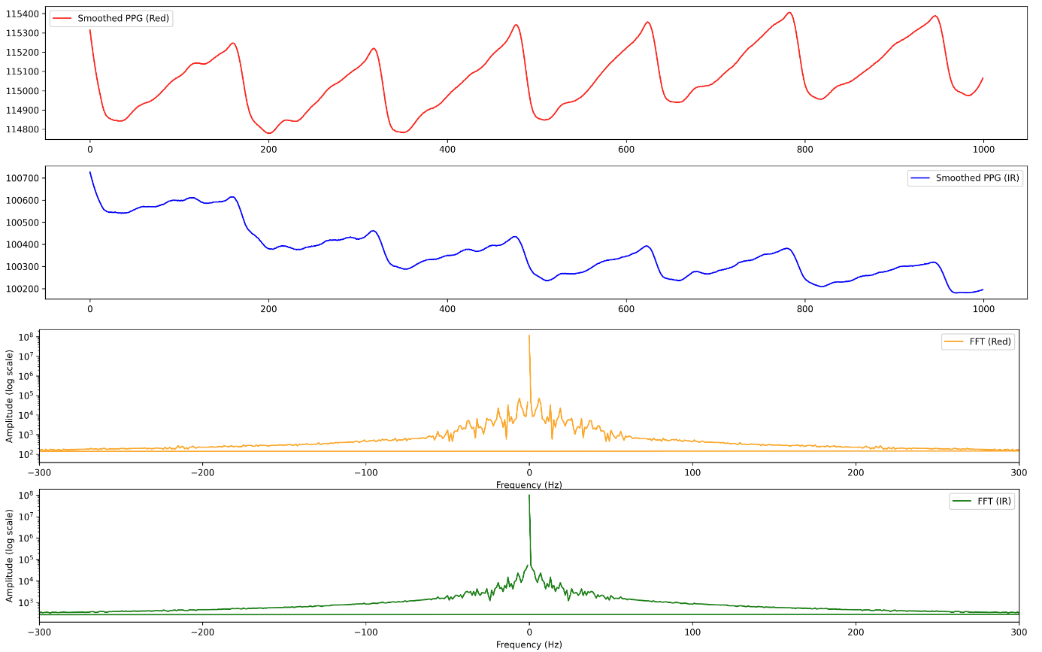


Smoothing

Slide 29
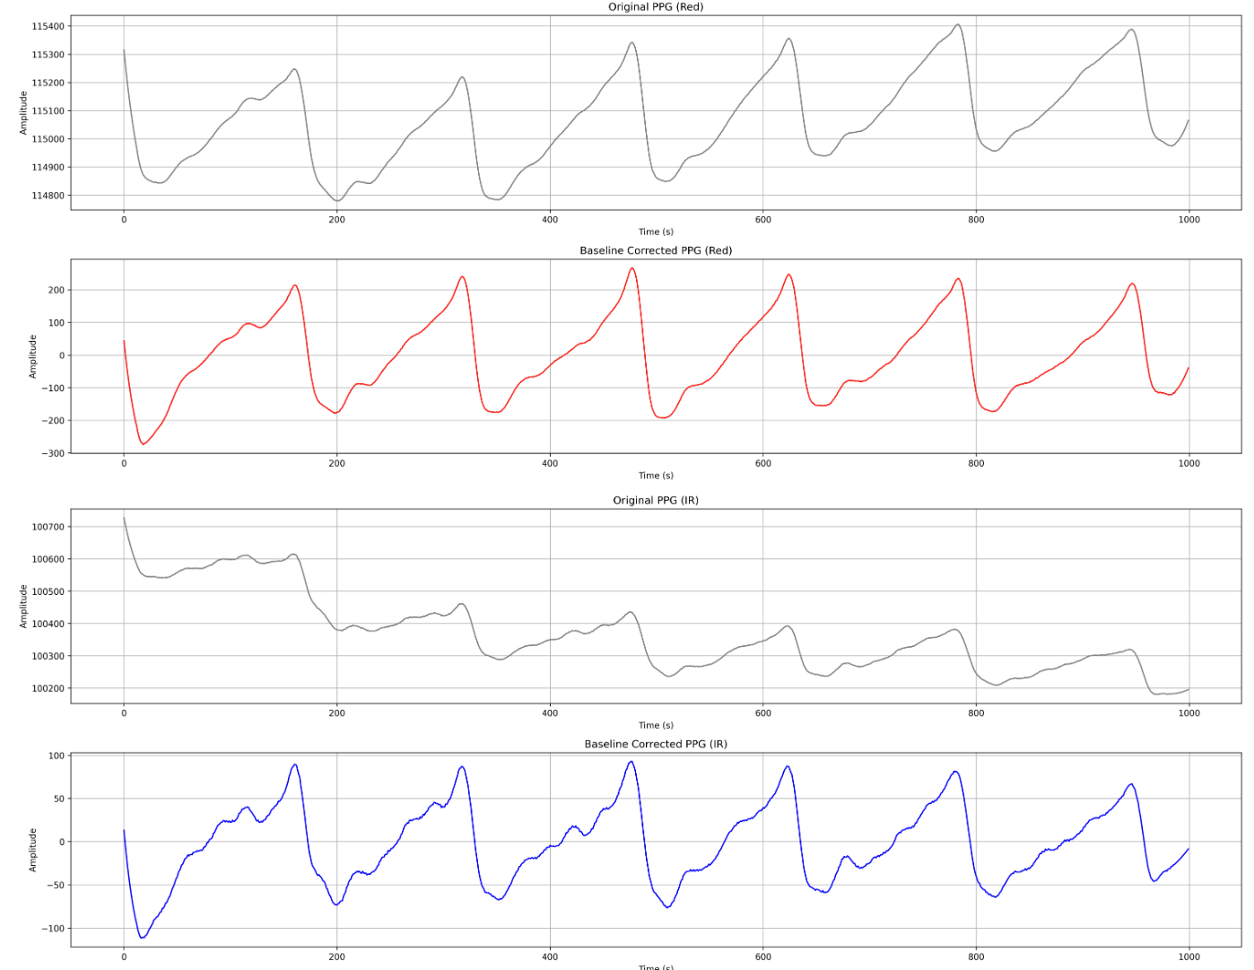
Drift correction

Slide 30
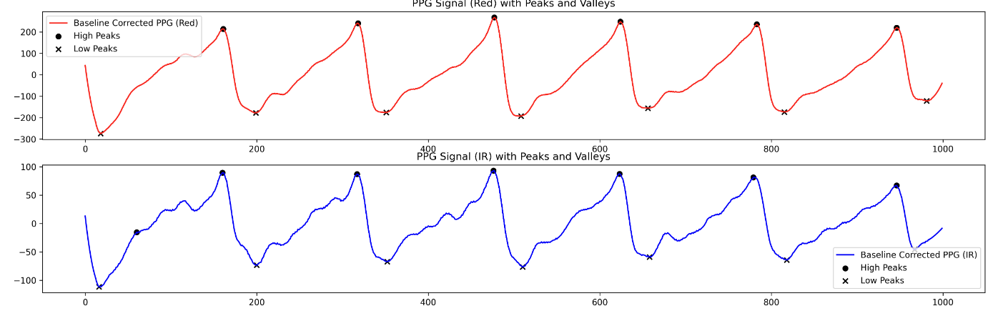
Peak detection

Slide 31
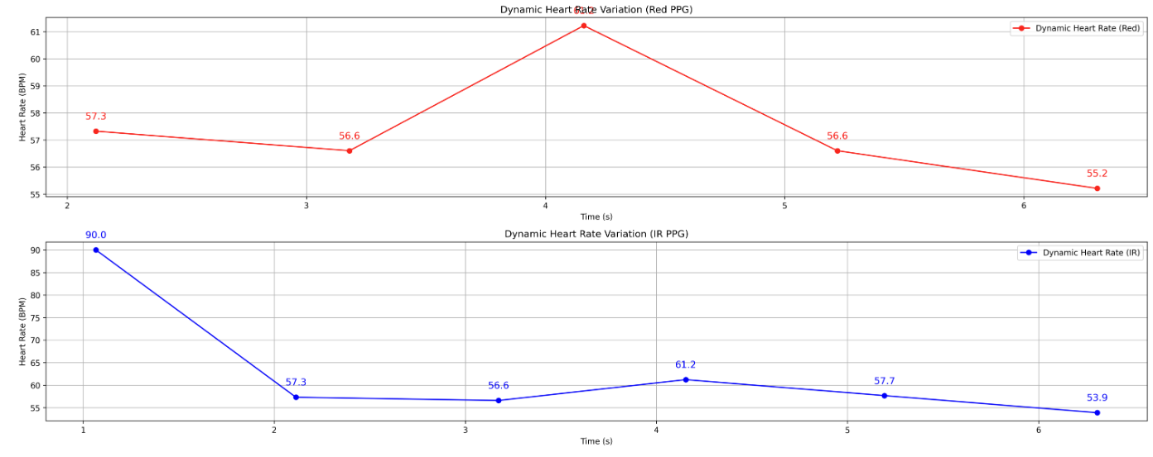
Heart rate

Slide 32
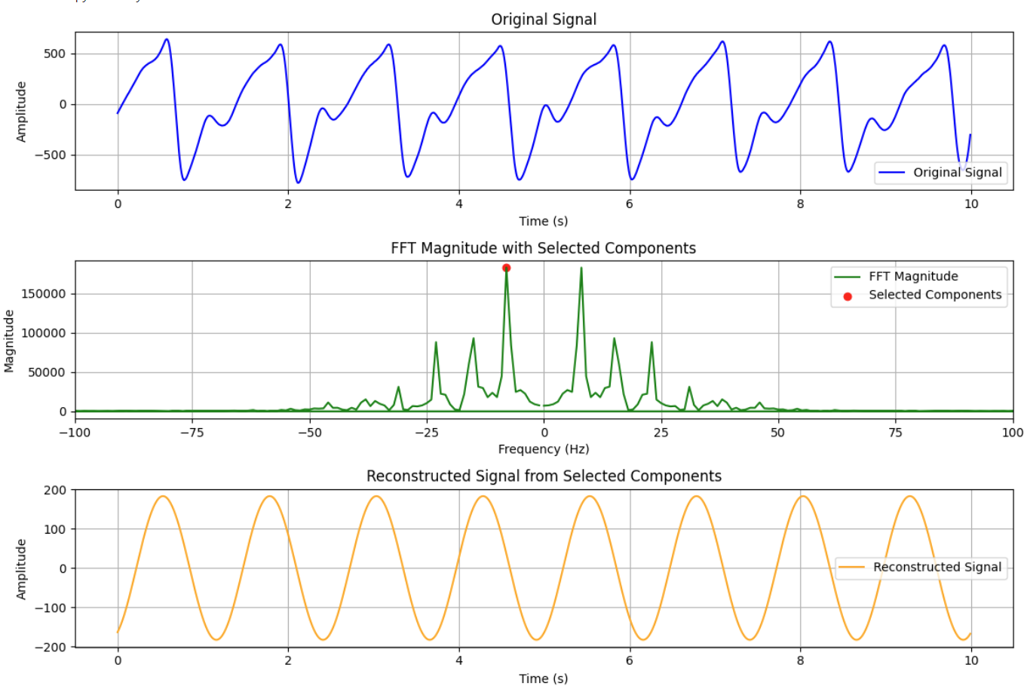


Using single component to find heart rate

Slide 33
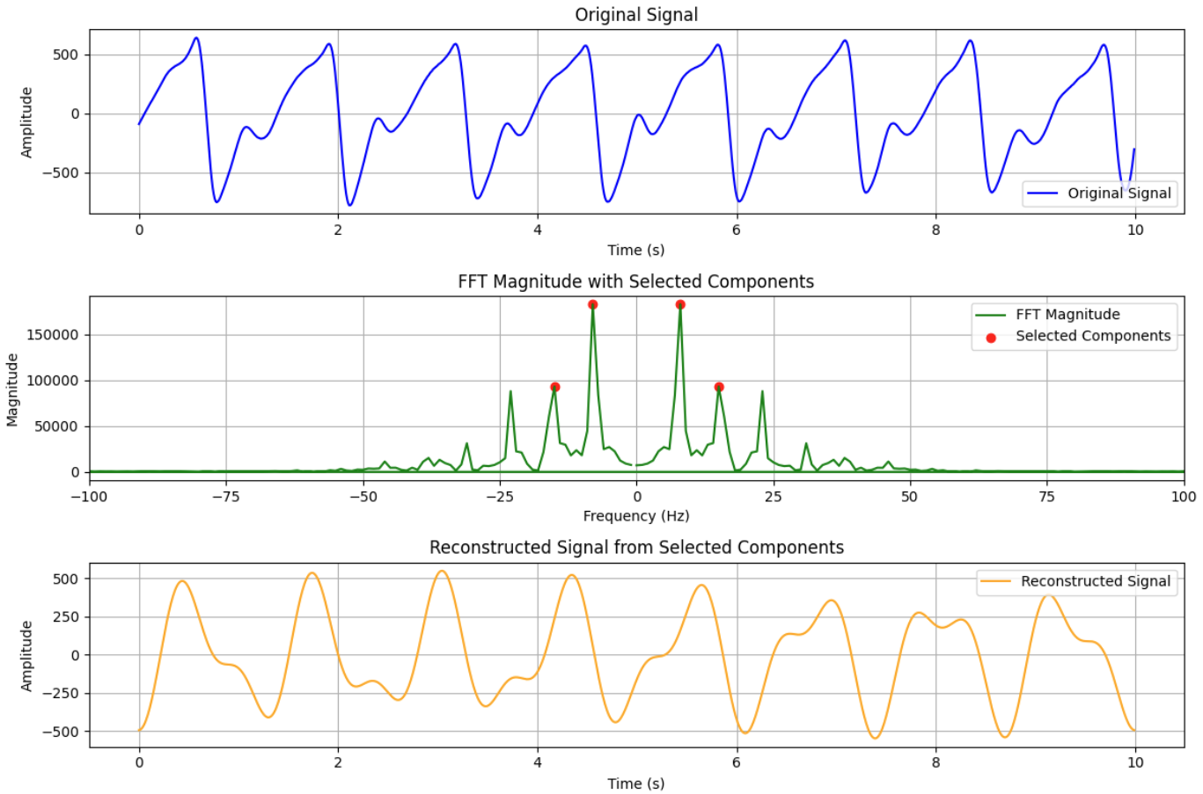
4 components in the PPG signal – signal loss

Slide 34
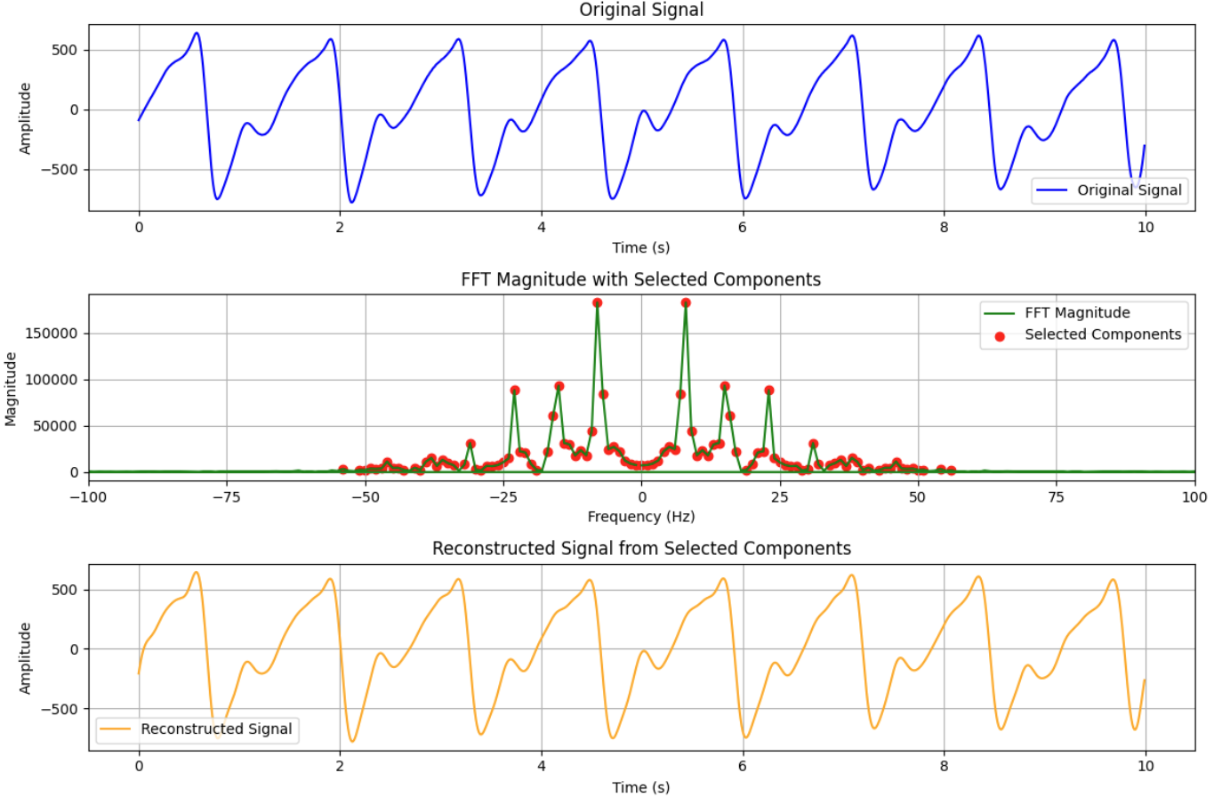



Taking all the components provides the original signal

